Slide 1
7 – Socket programming
Sangmyung Univ., Dept of HC-AI

Slide 2
Client/sever model
Client asks (request) – server provides (response)
Typically: single server - multiple clients
The server does not need to know anything about the client
  even that it exists
The client should always know something about the server
  at least where it is located
1. Client sends request
Client
process
Server
process
Resource
4. Client
handles
response
3. Server sends response
2. Server
handles
request
Note: clients and servers are processes running on hosts
(can be the same or different hosts).

Slide 3
Server-Client model in the Internet (TCP/IP)
Need to address the host & the process within.
The pair of {IP address + port number} → makes up a “socket-address”
Server socket address
208.216.181.15:80
Client socket address
128.2.194.242:3479
FTP Server
(port 21)
Client
HTTP Server
(port 80)
Connection socket pair
(128.2.194.242:3479, 208.216.181.15:80)
Client host address
128.2.194.242
Server host address
208.216.181.15
Note: 80 is a well-known port
associated with Web servers

Slide 4
Servers
Servers are long-running processes (daemons).
  Created at boot-time (typically)
  Run continuously until the machine is turned off.
Each server waits for requests to arrive on a well-known port associated with a particular service.
  Port 7: echo server
  Port 23: telnet server
  Port 25: mail server
  Port 80: HTTP server

Slide 5

Socket
what is a socket?
  Door (interface) between application process and end-end-transport protocol
  To the OS kernel, a socket is an endpoint of communication.
  Socket as an Application Programming Interface
    Supports the creation of network applications
Multiple processes, but One transport protocol entity
application
socket
application
controlled by
app developer
process
process
transport
transport
network
network
controlled
by OS
link
Internet
link
physical
physical

Slide 6


Multiplexing/demultiplexing at Transport layer
multiplexing at sender:
demultiplexing at receiver:
handle data from multiple
sockets, add transport header (later used for demultiplexing)
use header info to deliver
received segments to correct
socket
application
application
P1
P2
application
socket
P3
transport
P4
process
transport
network
transport
network
link
network
link
physical
link
physical
physical
A single transport layer instance handles many sockets

Slide 7
Socket types
Stream sockets
  allow processes to communicate using TCP. connection-oriented
  provides bidirectional, reliable, sequenced, and unduplicated flow of data with no boundaries.
  The socket type is SOCK_STREAM.
Datagram sockets
  allow processes to use UDP to communicate.
  supports bidirectional flow of messages.
  The socket type is SOCK_DGRAM.
  basically connectionless or
  can be connection-oriented (runtime library of socket API can create and maintain logical connections)
Raw
  provide access to ICMP.
  These sockets are normally datagram oriented
  Raw sockets are not for most applications.
  The socket type is SOCK_RAW.

Slide 8
Connectionless demultiplexing
for connectionless socket,
  one socket for a UDP process
  when host receives UDP segment:
    checks destination port number in segment
    directs UDP segment to socket with that port number
UDP/IP packets with same destination port number, but different source socket addresses will be directed to same socket at destination

Slide 9
Question:
  Server C has a UDP socket with port number X
  Client A and B send UDP segments to C with destination port number X.
  Will both of segments be directed to the same socket at C?
  If so, how will the process at C know that they are from different hosts?
Answer
  Yes, both segments will be directed to the same socket.
  For each received segment, at the socket interface, the operating system will provide the process with the source socket addresses to determine the origins of the individual segments.
Application program using UDP has to distinguish the packets from the different source socket addresses

Slide 10
Connection-oriented demux
one socket per TCP connection (a TCP process can have multiple sockets)
TCP socket identified by ‘4-tuple’:
  source IP address
  source port number
  dest IP address
  dest port number
demux: receiver (transport layer instance) uses all four values to direct segment to appropriate socket
server host may support many simultaneous TCP sockets:
  each socket identified by its own 4-tuple

Slide 11
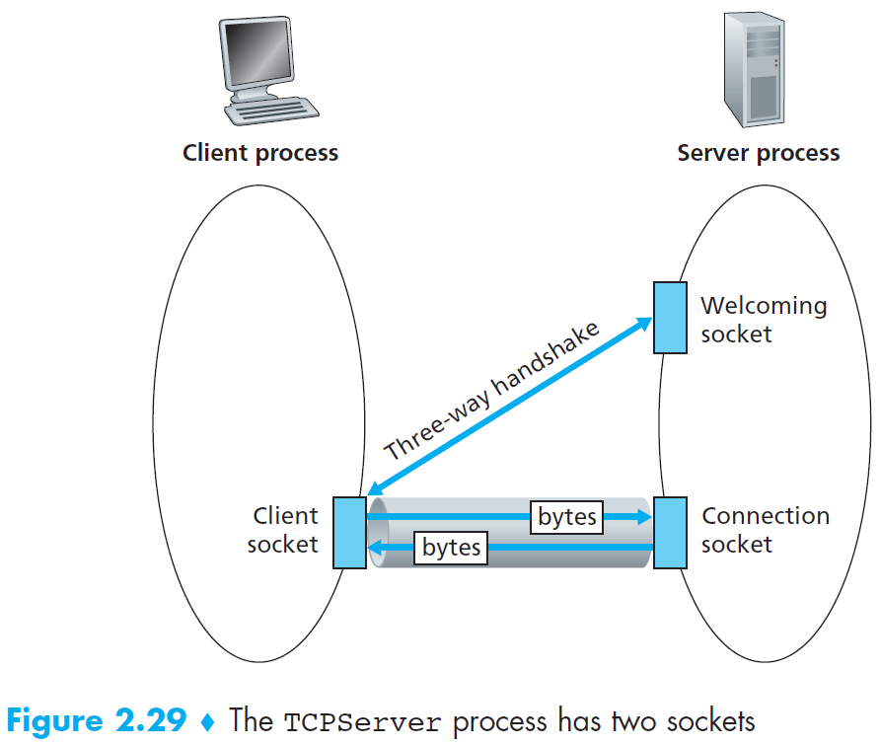
Connection-oriented demux
a server maintains a ‘welcoming socket’ for incoming request & handshake
the server assigns a different socket for each connected client
  some types of HTTP (non-persistent http) will have different socket for each request

Slide 12
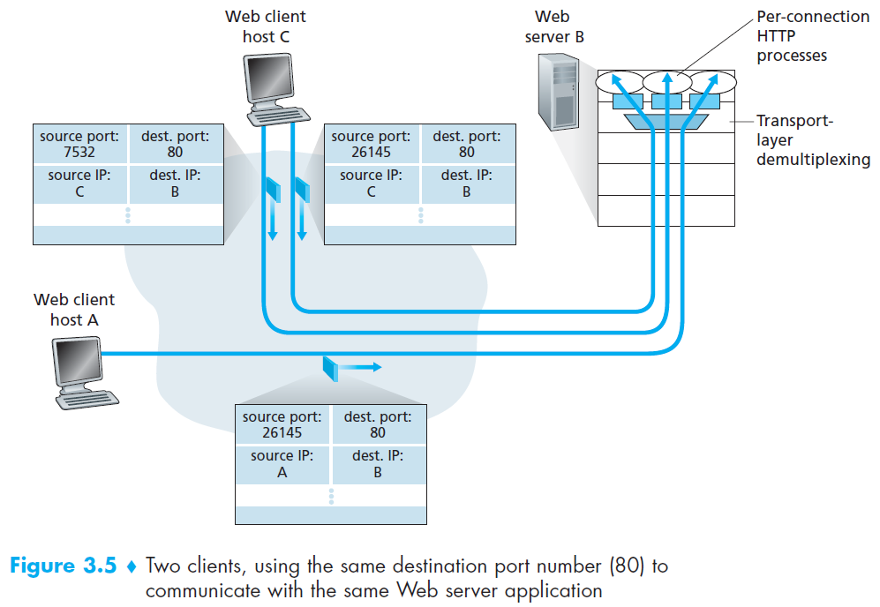
Connection-oriented demux: example

Slide 13
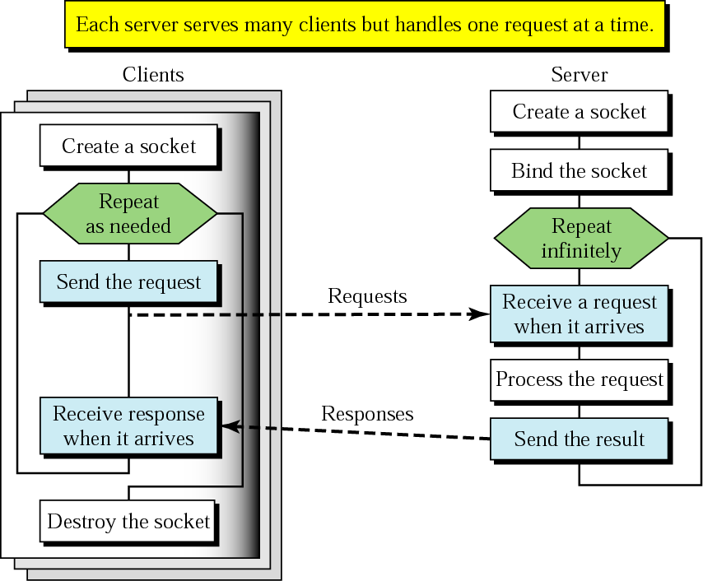
Client+server: connectionless (UDP)
socket()
bind()
sendto()
recvfrom()
sendto()
close()

Slide 14
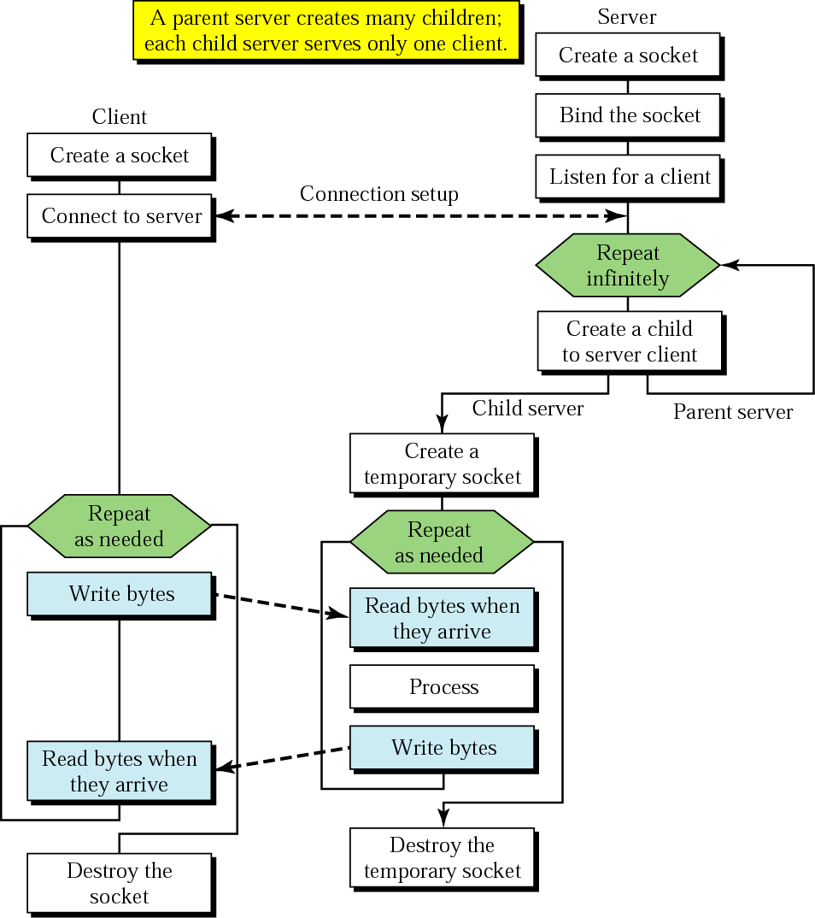
Client+server: connection-oriented (TCP)
bind()
socket()
listen()
connect()
TCP three-way handshake
accept()
send()
receive()
send()
receive()
close()
Concurrent server

Slide 15
echo_server_win (1/4)
#include <stdio.h>
#include <stdlib.h>
#include <string.h>
#include <winsock2.h>
/* #pragma warning(disable : 4996) */
#pragma comment(lib, "ws2_32.lib")
#define BUF_SIZE 1024
void ErrorHandling(char* message);
int main(int argc, char* argv[])
{
WSADATA wsaData;
SOCKET hServSock, hClntSock;
/* hServSock은 listening socket, hClintSock은 connecting socket임 */
/* Handle은 Windows에서 socket 자원을 식별하는 정수 값*/
char message[BUF_SIZE];
int strLen, i;
SOCKADDR_IN servAdr, clntAdr;
int clntAdrSize;
if (argc != 2) {
printf("Usage : %s <port>\n", argv[0]);
exit(1);
}

Slide 16
echo_server_win (2/4)
if (WSAStartup(MAKEWORD(2, 2), &wsaData) != 0)
/* WINSOCK ver 2.2 요청 (winsock library 초기화), 초기화한 library 정보를 WSADATA구조체에 저장 */
ErrorHandling(“WSAStartup() error!”);
hServSock = socket(PF_INET, SOCK_STREAM, 0);
if (hServSock == INVALID_SOCKET)
ErrorHandling(“socket() error”);
memset(&servAdr, 0, sizeof(servAdr));
servAdr.sin_family = AF_INET;
servAdr.sin_addr.s_addr = htonl(INADDR_ANY);
servAdr.sin_port = htons(atoi(argv[1]));
/* 구조체 변수 serAdr에 IP주소와 Port number 정보를 초기화한후, IP주소는 자동배정, Port number는 입력된 argument정보를 반영 */
if (bind(hServSock, (SOCKADDR*)&servAdr, sizeof(servAdr)) == SOCKET_ERROR)
ErrorHandling(“bind() error”);
if (listen(hServSock, 5) == SOCKET_ERROR)
ErrorHandling(“listen() error”);
clntAdrSize = sizeof(clntAdr);

Slide 17
echo_server_win (3/4)
for (i = 0; i < 5; i++)
/* 5개의 client에의 서비스 제공을 위한 반복문. accept함수가 5번 호출됨 */
{
hClntSock = accept(hServSock, (SOCKADDR*)&clntAdr, &clntAdrSize);
if (hClntSock == -1)
ErrorHandling("accept() error");
else
printf("Connected client %d \n", i + 1);
while ((strLen = recv(hClntSock, message, BUF_SIZE, 0)) != 0)
/* client에서 close 함수가 호출되면, 서버 소켓에 EOF가 전달되어 while 조건이 false가 됨 */
send(hClntSock, message, strLen, 0);
/* Windows socket에서는 write함수 대신 send함수를, read대신 recv를 사용 */
closesocket(hClntSock);
}
closesocket(hServSock);
WSACleanup(); /* WINSOCK 정리 */
return 0;
}

Slide 18
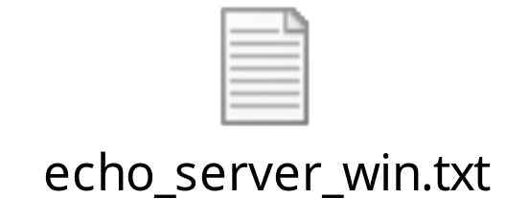
echo_server_win (4/4)
void ErrorHandling(char* message)
{
fputs(message, stderr);
fputc('\n', stderr);
exit(1);
}

Slide 19
echo_client_win (1/4)
#include <stdio.h>
#include <stdlib.h>
#include <string.h>
#include <winsock2.h>
/* #pragma warning(disable : 4996) */
#pragma comment(lib, "ws2_32.lib")
#define BUF_SIZE 1024
void ErrorHandling(char* message);
int main(int argc, char* argv[])
{
WSADATA wsaData;
SOCKET hSocket;
char message[BUF_SIZE];
int strLen;
SOCKADDR_IN servAdr;
if (argc != 3) {
printf("Usage : %s <IP> <port>\n", argv[0]);
exit(1);
}

Slide 20
echo_client_win (2/4)
if (WSAStartup(MAKEWORD(2, 2), &wsaData) != 0)
ErrorHandling("WSAStartup() error!");
hSocket = socket(PF_INET, SOCK_STREAM, 0);
if (hSocket == INVALID_SOCKET)
ErrorHandling("socket() error");
memset(&servAdr, 0, sizeof(servAdr));
servAdr.sin_family = AF_INET;
servAdr.sin_addr.s_addr = inet_addr(argv[1]);
servAdr.sin_port = htons(atoi(argv[2]));
/* 구조체 변수 servAdr에 IP주소와 Port number 정보를 초기화한후, IP주소와 Port number는 입력된 argument정보를 반영 */
if (connect(hSocket, (SOCKADDR*)&servAdr, sizeof(servAdr)) == SOCKET_ERROR)
ErrorHandling("connect() error!");
else
puts("Connected...........");

Slide 21
echo_client_win (3/4)
while (1)
{
fputs("Input message(Q to quit): ", stdout);
fgets(message, BUF_SIZE, stdin);
if (!strcmp(message, "q\n") || !strcmp(message, "Q\n"))
/* q 혹은 Q를 message로 입력 받으면 break */
break;
send(hSocket, message, strlen(message), 0);
strLen = recv(hSocket, message, BUF_SIZE - 1, 0);
message[strLen] = 0; /* null character를 string 마지막에 삽입 */
printf("Message from server: %s", message);
}
closesocket(hSocket);
WSACleanup();
return 0;
}

Slide 22
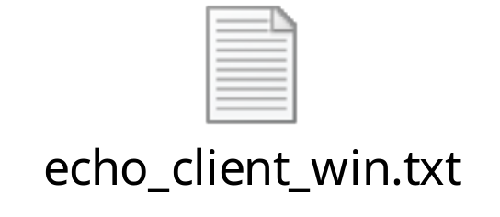
echo_client_win (4/4)
void ErrorHandling(char* message)
{
fputs(message, stderr);
fputc('\n', stderr);
exit(1);
}

Slide 23
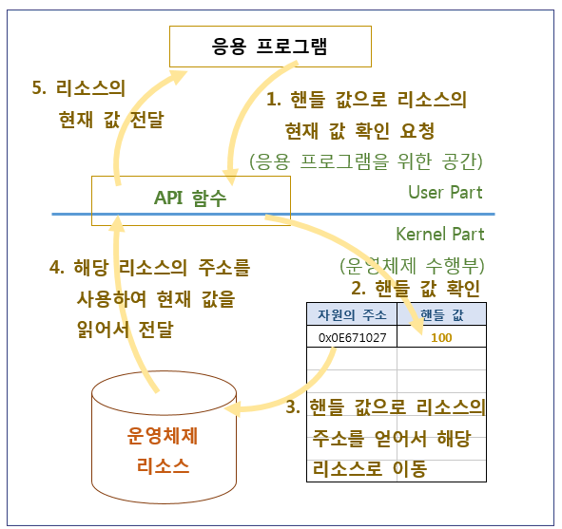
Windows에서 Handle의 의미
Socket은 windows에서는 handle로 취급함
handle:
  운영체제 내부 리소스의 주소를 정수로 치환한 값
  운영체제 리소스를 안전하게 관리하기 위해 주소 대신 이와 연결된 핸들 값을 알려주어 접근하게 한다.
따라서 SOCKET datatype은 실제로는 정수 값을 가짐

Slide 24
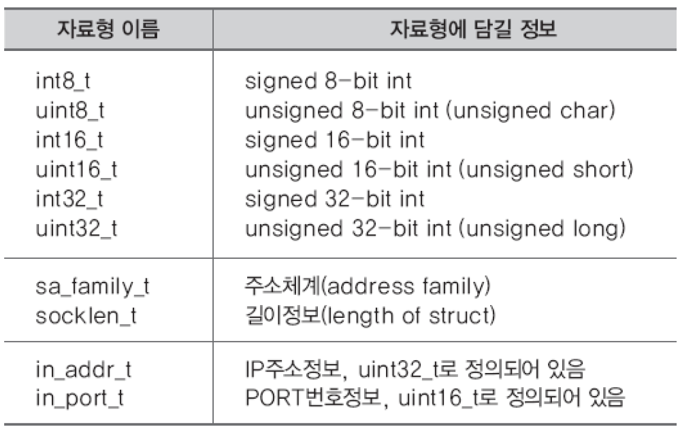
Some definitions on data types
u_char unsigned 8-bit character
u_short unsigned 16-bit integer
u_long unsigned 32-bit integer

Slide 25
Creating and Deleting Sockets
int sd=socket(int protofamily, int type, int protocol)
Creates a new socket. Returns a socket descriptor (sd) or -1 (error)
Must specify:
  the protocol family (e.g. PF_INET for IPv4, PF_INET6 for IPv6)
  the type of service (e.g. SOCK_STREAM or SOCK_DGRAM)
  the protocol (e.g. typically 0)
example:
int sd = socket(PF_INET, SOCK_STREAM, 0);
int close(int sd)
Deletes socket.
Returns 0 on success; -1 otherwise & set errno
For connected STREAM sockets, sends EOF to close connection.

Slide 26
bind( ) and listen( )
int bind(int sd, struct sockaddr* myaddr, int addrlen)
Returns 0 on success; -1 otherwise & set errno
Assign a socket address to the socket.
When server has more than one IP addrs, can specify “ANY”, or a specific one
addrlen: length of the address structure
int listen(int sd, int queuesize)
Returns 0 on success; -1 otherwise & set errno
Used by connection-oriented servers only: announce willing to accept connections
queuesize: sets how many pending connections can be waiting

Slide 27
connect( )
connect (sd, saddress, saddreslen)
Used by connection-oriented clients to connect to server
  There must already be a socket bound to a connection-oriented service on the sd
  There must already be a listening socket on the server
  You pass in the address (IP address, and port number) of the server.

Slide 28
accept( )
int asd = accept(int sd, struct sockaddr* client_address, int* addrlen)
Returns an (accepting) socket descriptor on success; -1 otherwise & set errno
Used by connection-oriented servers to accept one new connection
  There must already be a listening socket (sd)
  Returns asd, a new socket for the new connection
  client_address: The socket address of the client (returned from the client request)
  addrlen: length of the address structure. A pointer to int set to sizeof(struct sockaddr)

Slide 29
read( ) & receive( )
int read(int sd, char* data, size_t length)
read data from a stream (TCP) or ‘connected’ datagram (UDP) socket.
return number of bytes read; or -1
length: number of bytes to try to read
read(sd, data, length) == receive(sd, data, length, 0), where flags in receive function is set to 0.

Slide 30
write( ) & send( )
int write (int sd, char* data, size_t length)
write data to a stream (TCP) or ‘connected’ datagram (UDP) socket.
return number of bytes written; or -1
length: number of bytes to try to write
maybe failed if
  process received interrupt
  kernel resources unavailable
write(sd, data, length) == send(sd, data, length, 0), where flags in receive function is set to 0.

Slide 31
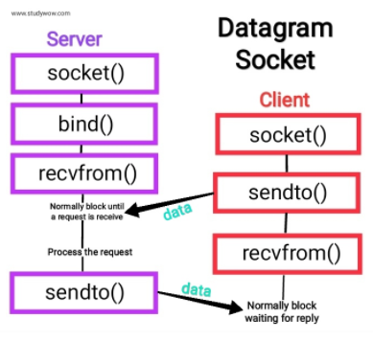
sendto( ) & recvfrom( )
sendto (sd, data, length, flags, destaddress, addresslen)
Used by connectionless clients to specify a “default send to address”
recvfrom (sd, data, length, flags, srcaddress, addresslen)
Used to receive data… parameters are similar, but in reverse
(destination => source, etc…)

Slide 32
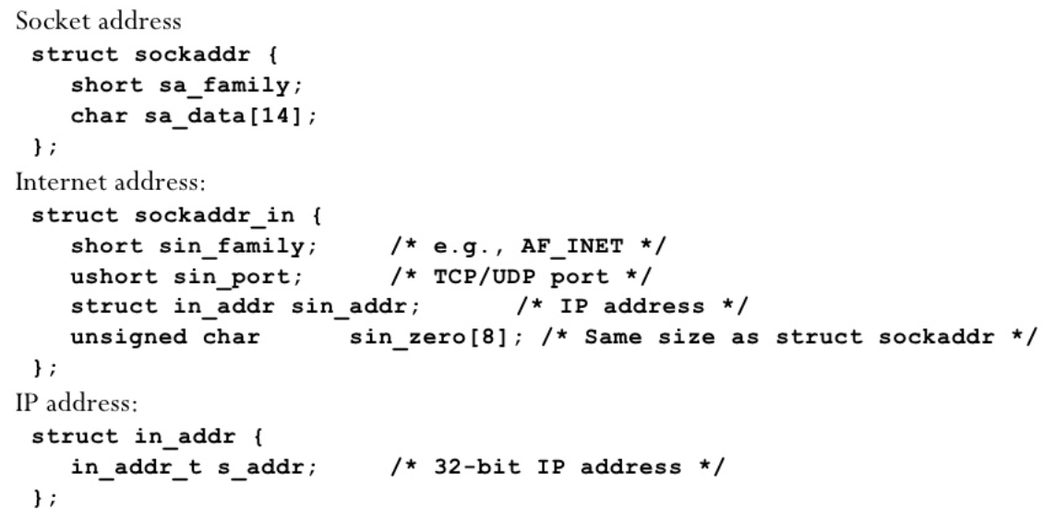
Socket address structure
short: 2byte
u_short: 2byte
struct in_addr: 4byte
sin_zero[8]: 전체 크기를 struct sockaddr (16byte)와 같게 만들기 위한 padding

Slide 33
Lab 06 Windows
Socket programming

Slide 34
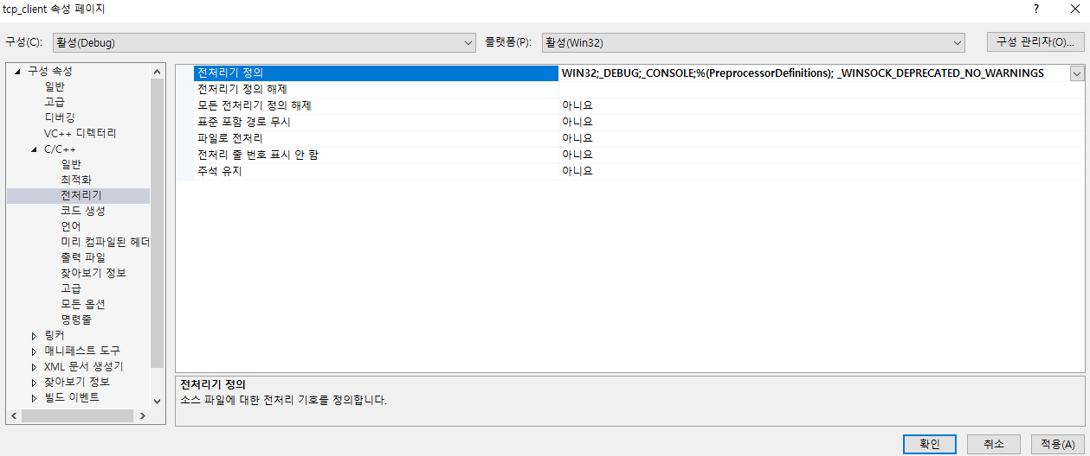
Lab activities
Create projects for echo_server & echo_client at Visual Studio 2019 with the codes given in this PPT
다음을 추가해야 함 (필요한 경우)
  #pragma warning(disable : 4996)
  #pragma comment(lib, "ws2_32.lib")
  _WINSOCK_DEPRECATED_NO_WARNINGS

Slide 35
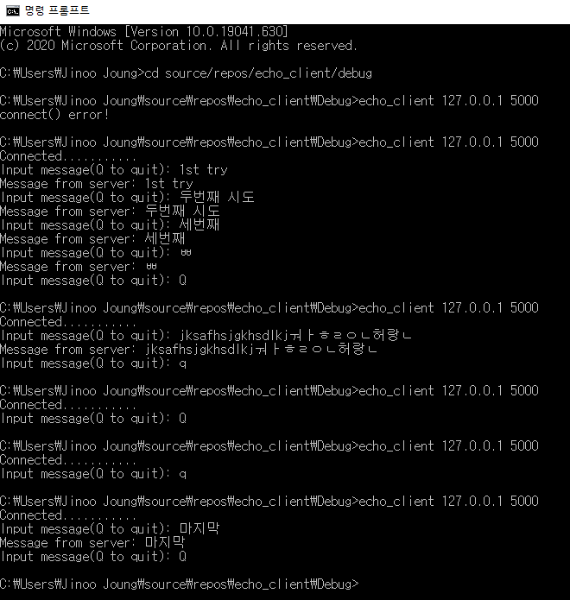
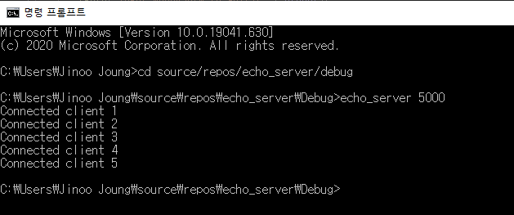
Lab activities
run the executables with CMD prompt
  127.0.0.1 is the special IP address (loopback address) that indicates the host itself

Slide 36
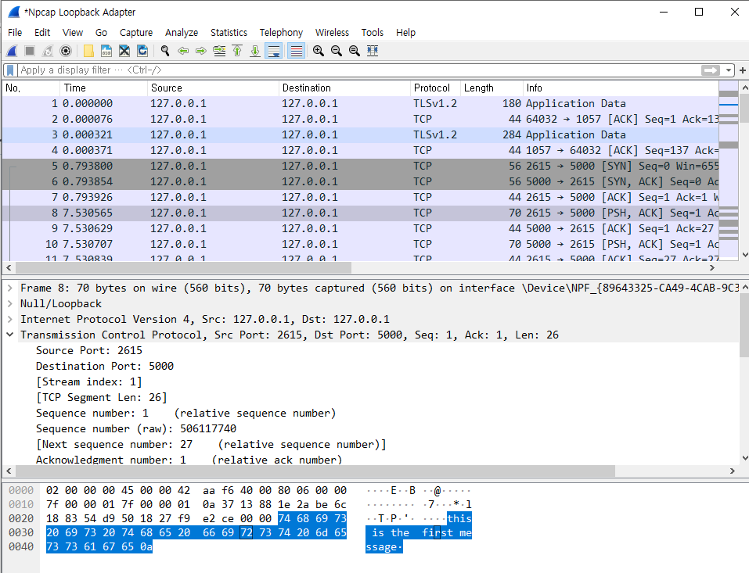
Lab activities
Analyze with Wireshark & Discuss the results
  Select the Loopback Adapter interface in Wireshark

